Slide 1

AISC1004 Deterministic Models & Optimization
Fall Semester 2023
Saturday 12:15 PM – 3:00 PM
Qasim Ali

Slide 2
Agenda - Week 6 –DMO –LR advanced II
Learning Outcomes
Housekeeping
Linear Regression – Advanced

Slide 3
Learning Outcomes –LinearR Advanced II
You will understand various complications related to performing LR using the methods learned so far
You will learn how to get around these issues, and
Appreciate the pros and cons of them

Slide 4
Housekeeping - timetable
Week | Theme | Objectives | Evaluation
Week 1 | Understanding Algorithms | Convexity & Processes | -
Week 2 | Linear Programming I | Graphical, Algebraic Solutions | -
Week 3 | Mathematical modeling | Constraint optimization models | In-class Application Exercise#1 – 10%
Week 4 | LPII - Simplex I | The simplex method | In-class Application Exercise#2 – 10%
Week 5 | LPIII - Simplex II | Duality, Cycling, Degeneracy | In-class Application Exercise#3 – 10%
Week 6 | Linear Regression | Multivariate LR | -
Week 7 | Mid-term Exam -20%
----------------------------------Week 8 – Study Week----------------------------------
Week 9 | Filtering | Kalman Filtering | -
Week 10 | PCA | Standardizat’^{n}, normaliza’^{n}, unbiasing | -
Week 11 | PCA II | SVD | In-class Application Exercise#4 – 10%
Week 12 | Graph Theory I | Terms, development, applications | In-class Application Exercise#5 – 10%
Week 13 | GT II & Networking | PCA, routing probs, Kruskal, Djikstra | In-class Application Exercise#6 – 10%
Week 14 | Final Exam – 20%
Week 15 | GT III & Networking II | Prim, Bottleneck, MST
* 8: last date to drop w/o academic penalty, see me if you are struggling

Slide 5
DMO –Linear Regression –Advanced
Y(x_{i}) = mX + b
Choose m, b so that Y (x_{i}) is close to y_{i} for each data point.
}residual
y_{i}
Cost Function:
J(m,b) = (1/n) Σ (Y(x_{i})-y_{i})²
Y(x_{i})

Slide 6
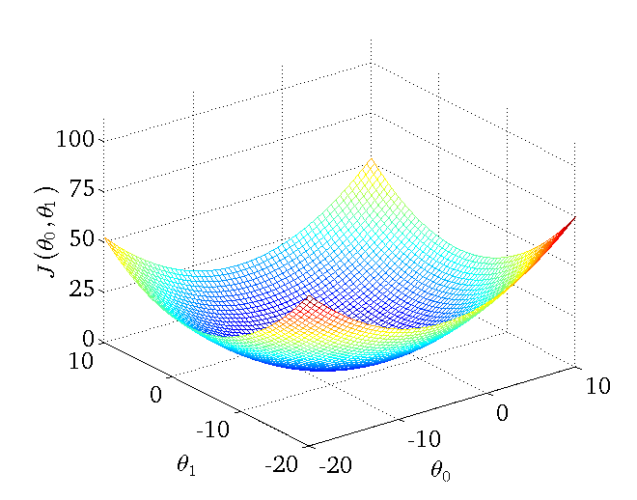
DMO –Linear Regression –Advanced
}residual
y_{i}
Y(x_{i})
Goal: Minimize J(m,b)
Method 1:
analytically using algebra
Method 2:
∂_{m,b}J=0
J(m,b) = (1/n) Σ (Y(x_{i})-y_{i})²

Slide 7
DMO –LR –Advanced –Batch GD
Recall: b_{i+1} = b_{i} +2α$\frac{Σ\left(y−y′\right)}{n}$
m_{i+1} = m_{i} +2α$\frac{Σx\left(y−y′\right)}{n}$
What does the convergence look like?
Δm,b vs n

Slide 8
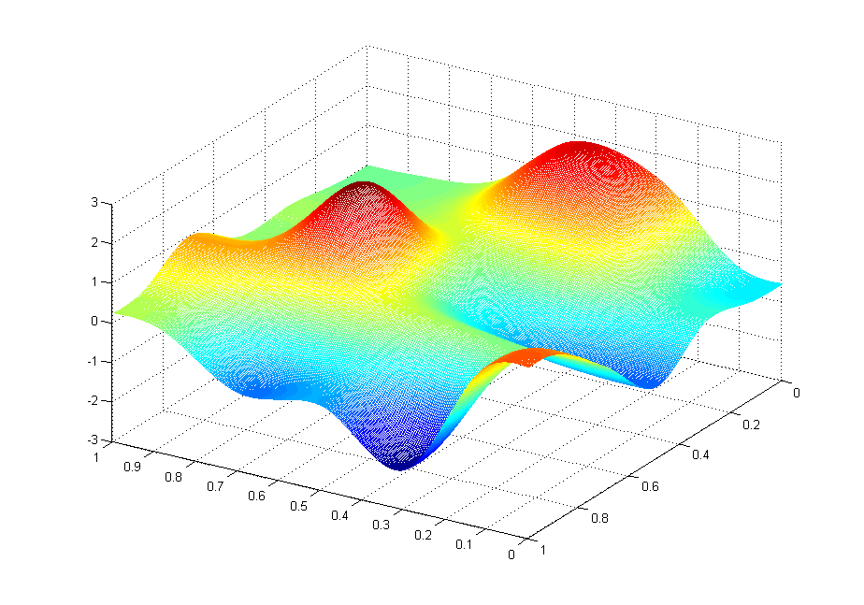
DMO –LR –Advanced –Batch GD
Recall:
There may be more than one path:
What problem can occur?
What can we do?

Slide 9
DMO –LR –Advanced –Batch GD
The issue is that we are calculating the gradient using the entire batch of data! Every single point. We then took that to update the values of m & b and rinse & repeat until we were satisfied there was convergence (below a threshold).
So instead, let’s not do that.

Slide 10
DMO –LR –Advanced –Stochastic GD
Pick only 1 data point, and find its gradient.
How do we choose?
At random.
Then update m, b and do it again, and again, until…
Convergence!
Epoch = a pass over the entire set
Iterations = pass over one gradient step

Slide 11
DMO –LR –Advanced –Stochastic GD
Pros: Cons:
Fast! Low memory (O(1) vs O(N)). Unstable.
Less susceptible to local min. Might not converge.
Highly susceptible to scaling
Δm,b vs n
J(m,b) vs i

Slide 12
DMO –LR –Advanced –Mini batch GD
Is there a way to minimize the cons and get some of the pros?
We can do something in between. Take some of the data. Not all, not one. Start with ½, ¼…?
Now we have another hyperparameter to worry about.
But it is the preferred method.

Slide 13
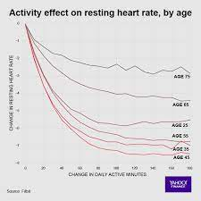
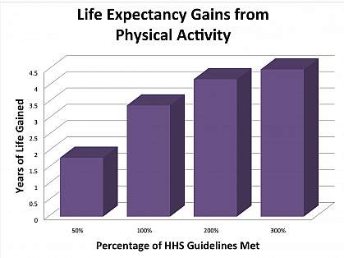
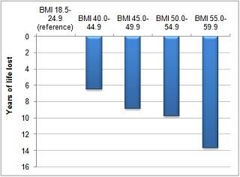
DMO –LR –Advanced–Multiple Linear Regression
Recall: Assumptions in LR?
Homoscedasticity
Independence
Normality of residuals
Linearity
What happens when variables are not independent?
E.g. Lifespan vs Obesity & Exercise

Slide 14
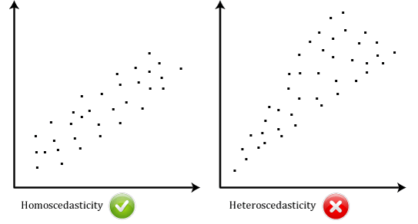
Homoscedasticity

Slide 15
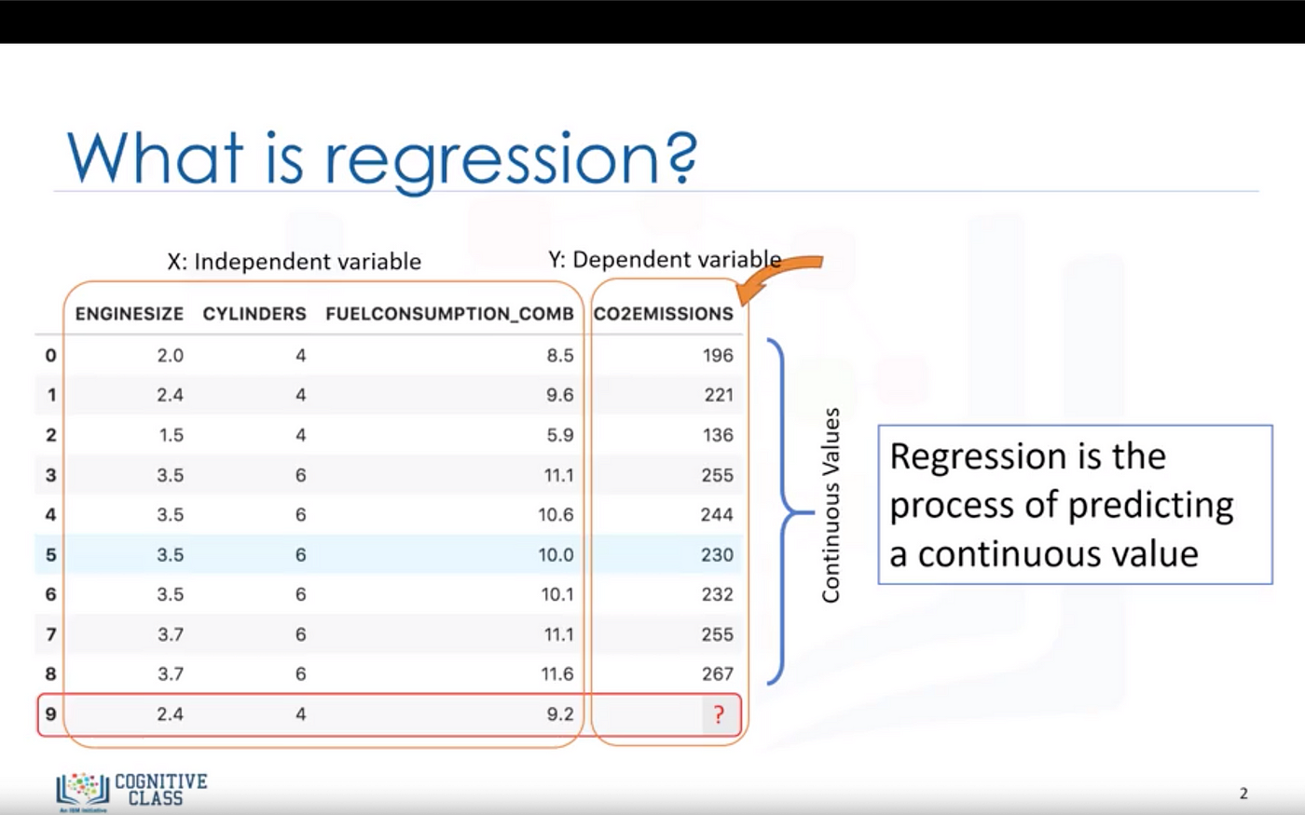
Independence

Slide 16
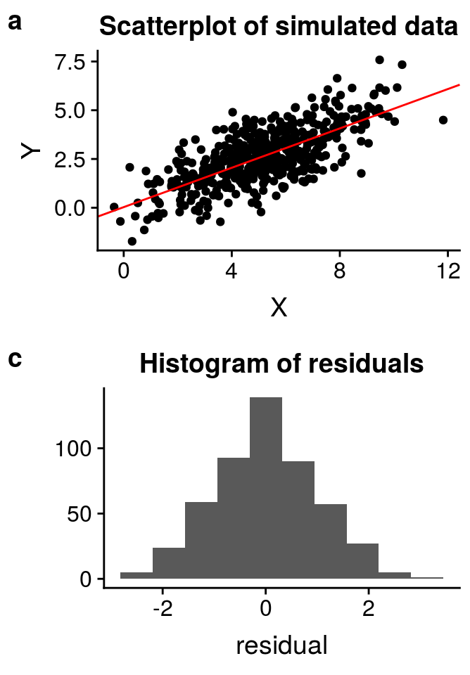
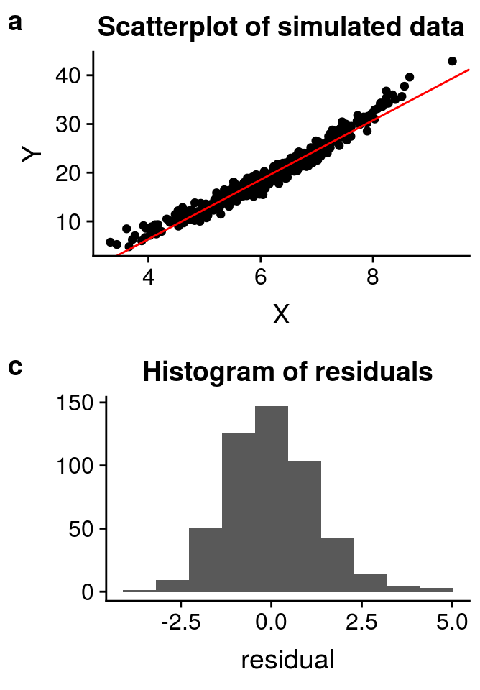
Normality of Residuals
VS

Slide 17
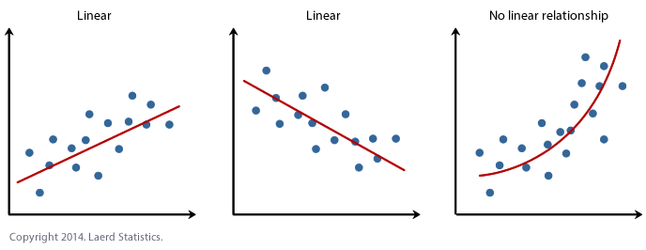
Linearity

Slide 18
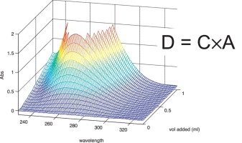
DMO –LR –Advanced–Multiple Linear Regression
In other words, y = b + m₁x₁ + m₂x₂ + m₃x₃ + …
Insurance premiums α ?
health, gender, age, job, marital status, income, smoker…

Slide 19
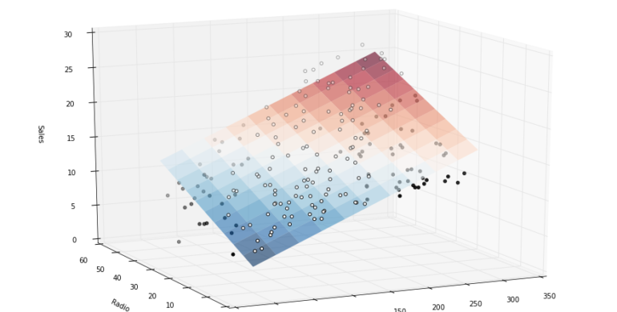
DMO –LR –Advanced–Multiple Linear Regression
In other words, y = b + m₁x₁ + m₂x₂ + m₃x₃ + …
Gas prices α ?
geography, competition, int’l oil prices…

Slide 20
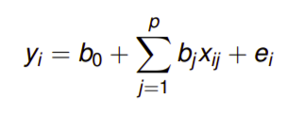
DMO –LR –Advanced–Multiple Linear Regression
Do NOT confuse with multi-variate linear regression!
We have only one (1) dependent variable!
#predictors slope of j^{th} predictor
Response to i^{th} data j^{th} predictor for i^{th} data
Regression intercept
predictor | 1 | 2 | … | P
Data
1
2
…
N

Slide 21
DMO –LR –Advanced–Multiple Linear Regression
linear
Y = Xb + e,
these are vectors: Y = (y₁, y₂,... y_{n})
linear | p=1
Data
1
2
…
N

Slide 22
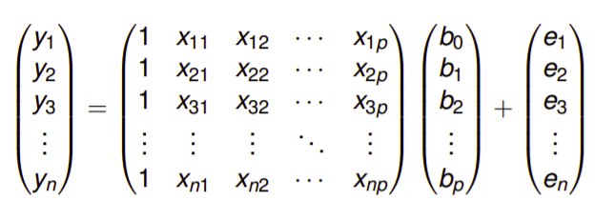
DMO –LR –Advanced–Multiple Linear Regression
Y = Xb + e
In matrix form:
Now you can see why we would GD & python!

Slide 23
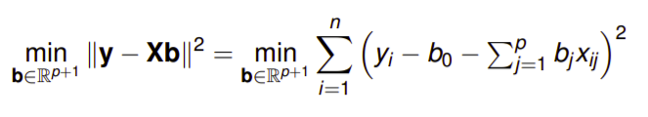
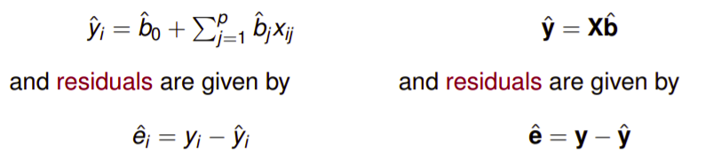
DMO –LR –Advanced–Multiple Linear Regression
We can revert back to our optimization problem:
J= =
1-d n-dim
fit/
predict
residual

Slide 24
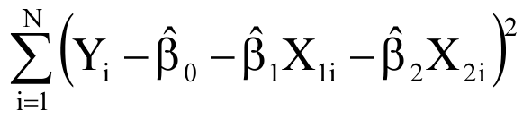
DMO –LR –Advanced–Multiple Linear Regression
So how do we actually solve it?
The same way!
Minimize the Error:
Knowns

Slide 25
DMO –LR –Advanced–Multiple Linear Regression
Next step?
2. Differentiate w.r.t. unknowns:
∂β_{i} (use power & chain rules)

Slide 26
DMO –LR –Advanced–Multiple Linear Regression
Next step?
Set ∂β_{i} =0
Rearrange (linear algebra)
You will get a system of
N equations, N unknowns so we can solve for β_{i} directly

Slide 27
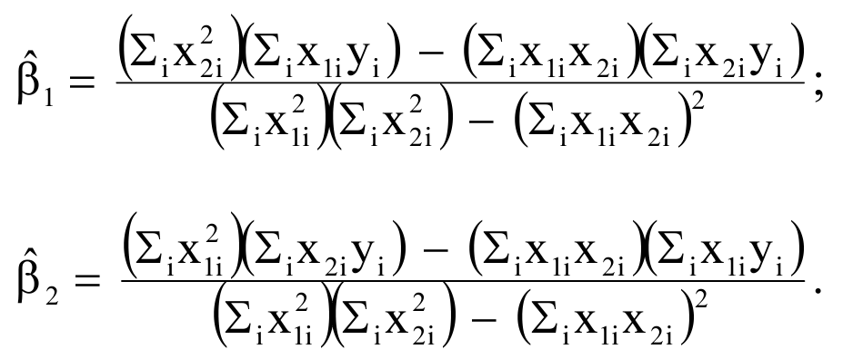
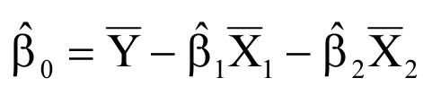
DMO –LR –Advanced–Multiple Linear Regression
Next step?
6. Use the property of averages

Slide 28
DMO –LR –Advanced–Multiple Linear Regression
Next step?
Similarly you can find the variances
and co-variances

Slide 29
DMO –Multiple LR - Recap
Y(x_{i}) = mX + b
Choose m, b so that Y (x_{i}) is close to y_{i} for each data point.
J(m,b) = (1/n) Σ (Y(x_{i})-y_{i})²

Slide 30
DMO –Multiple LR & SGD- Recap
GD = batch GD But for large datasets, multiple features
this will take time & resources.
So don’t use all the data (SGD):
-take random subsets each round
-converge faster!
What does the convergence look like?
Δm,b vs n
Δm,b vs n

Slide 31
DMO –Multiple LR & SGD- Recap
But beware there were multiple pros/cons of either method
So to strike a balance we can use a (MBGD) hybrid approach:
Take some (½, ¼?) of the data...

Slide 32
DMO –Multiple LR & SGD- Recap
For systems that depend on multiple factors, we typically would have to remodel our linear regression method, using multiple independent variables.
E.g. gas prices α weather, supply-demand, policy…
y = b + m₁x₁ + m₂x₂ + m₃x₃ + …
We can solve the model the same way using partial derivatives etc. under several assumptions of LR.

Slide 33
DMO –Multiple LR & SGD- Recap
For systems that depend on multiple factors, we typically would have to remodel our linear regression method, using multiple independent variables.
E.g. gas prices α
weather, supply-demand, policy…
y = b + m₁x₁ + m₂x₂ + m₃x₃ + …
#predictors slope of j^{th} predictor
Response to i^{th} data
j^{th} predictor for i^{th} data
Regression intercept

Slide 34
DMO –Multiple LR & SGD- Recap
linear
Y = Xb + e, these are data vectors: Y = (y₁, y₂,... y_{n})

Slide 35
DMO –LR –Advanced II –Multivariate LR
What happens if we want to make a decision such as rent or buy, and all we have is size of the place?
Purchase Price ($K) | Monthly Rent ($/mos) | Square Footage (ft²)
1100 | 2400 | 3000
700 | 1800 | 2000
400 | 650 | 1000
… | … | …

Slide 36
DMO –LR –Advanced II –Multivariate LR
Now we have 2 response (dependent) variables, and 1 explanatory (independent) variable
sale | rent | area
240101 | 5214 | 3750
111185 | 2359 | 1250
148629 | 2302 | 1250
228372 | 6192 | 4650
158610 | 4525 | 3150
201467 | 5562 | 4300
246000 | 5582 | 4000
286288 | 6183 | 4750
213471 | 4756 | 3100
120898 | 1956 | 800
191523 | 3353 | 2300
180191 | 3526 | 2150
188883 | 4407 | 3050
94712 | 3228 | 1700
203902 | 5326 | 4200
252018 | 6359 | 4950
139800 | 2419 | 1000
… | … | …

Slide 37
DMO –LR –Advanced II –Multivariate LR
In effect we have done nothing new, we only treat each problem separately. Why?
y_{ik} = b_{0k} + b_{k}x_{i} + ε_{0k}
y_{i1} = b₀₁ + b₁x_{i} + ε₀₁
y_{i2} = b₀₂ + b₂x_{i} + ε₀₂
We could rewrite in matrix form however these are a very limited class of problems. Instead let’s look at something more realistic.

Slide 38
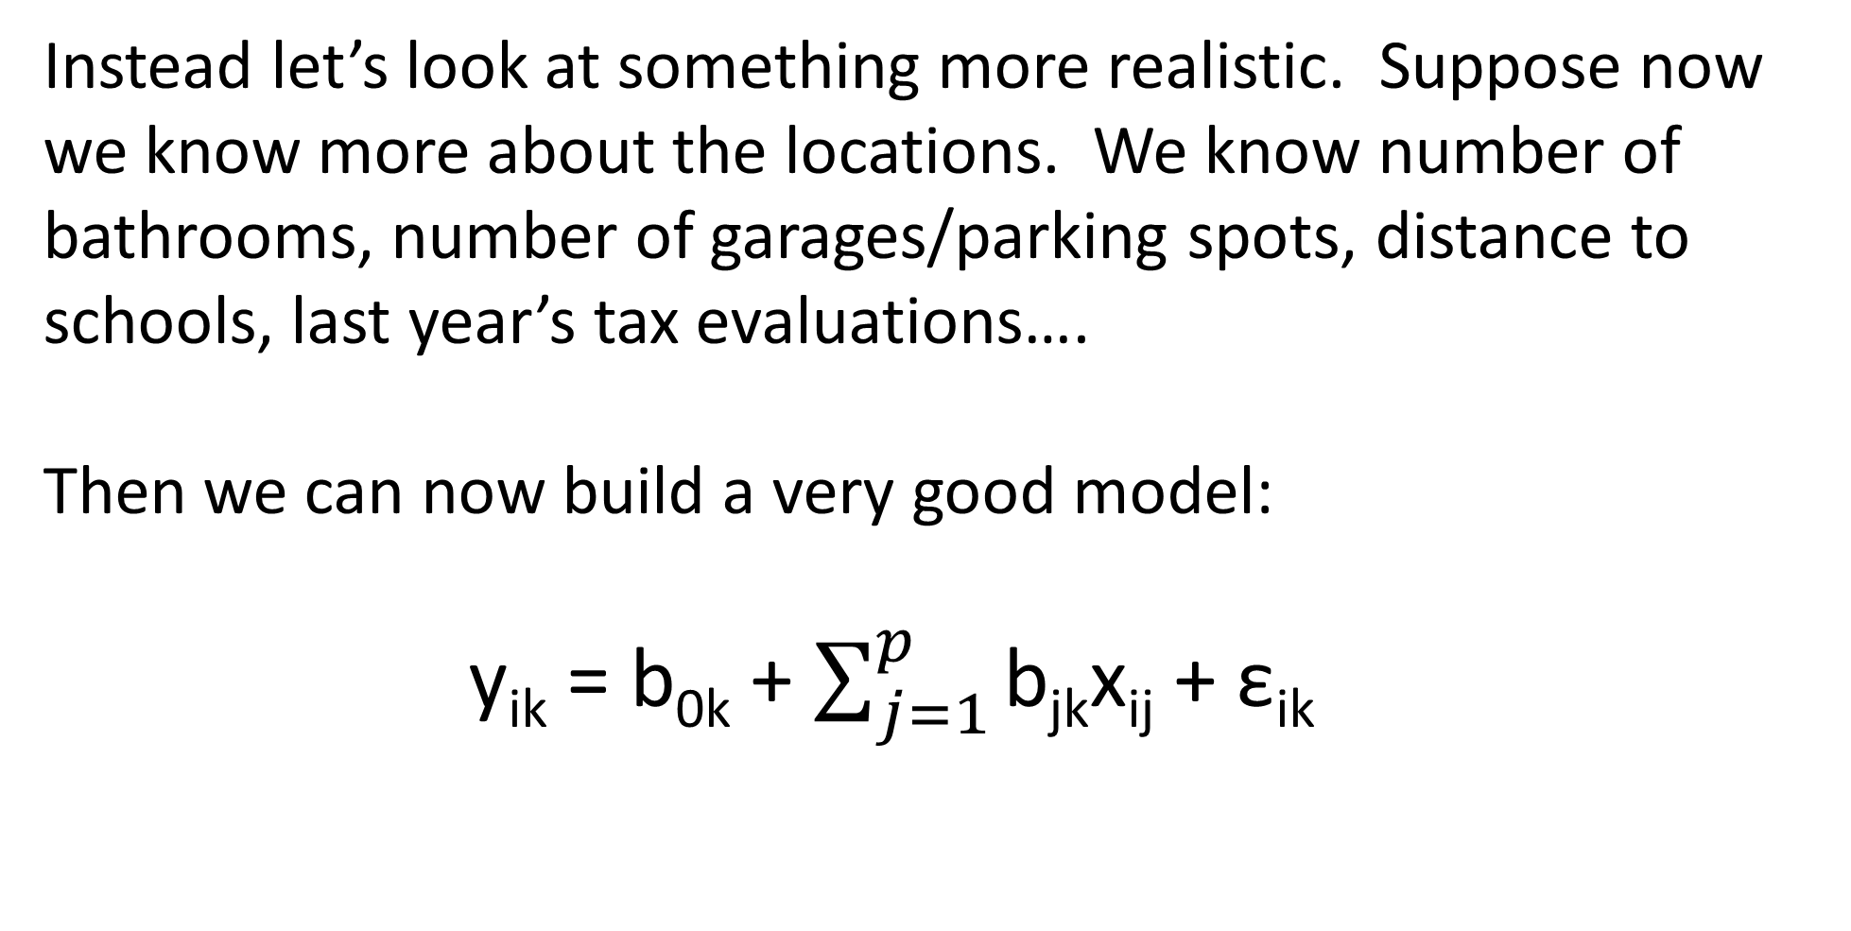
DMO –LR –Advanced II –Multivariate Multiple LR
Instead let’s look at something more realistic. Suppose now we know more about the locations. We know number of bathrooms, number of garages/parking spots, distance to schools, last year’s tax evaluations….
Then we can now build a very good model:
y_{ik} = b_{0k} + $\sum_{j=1}^{p}{\text{b}\text{jk}\text{x}\text{ij}}$ + ε_{ik}

Slide 39
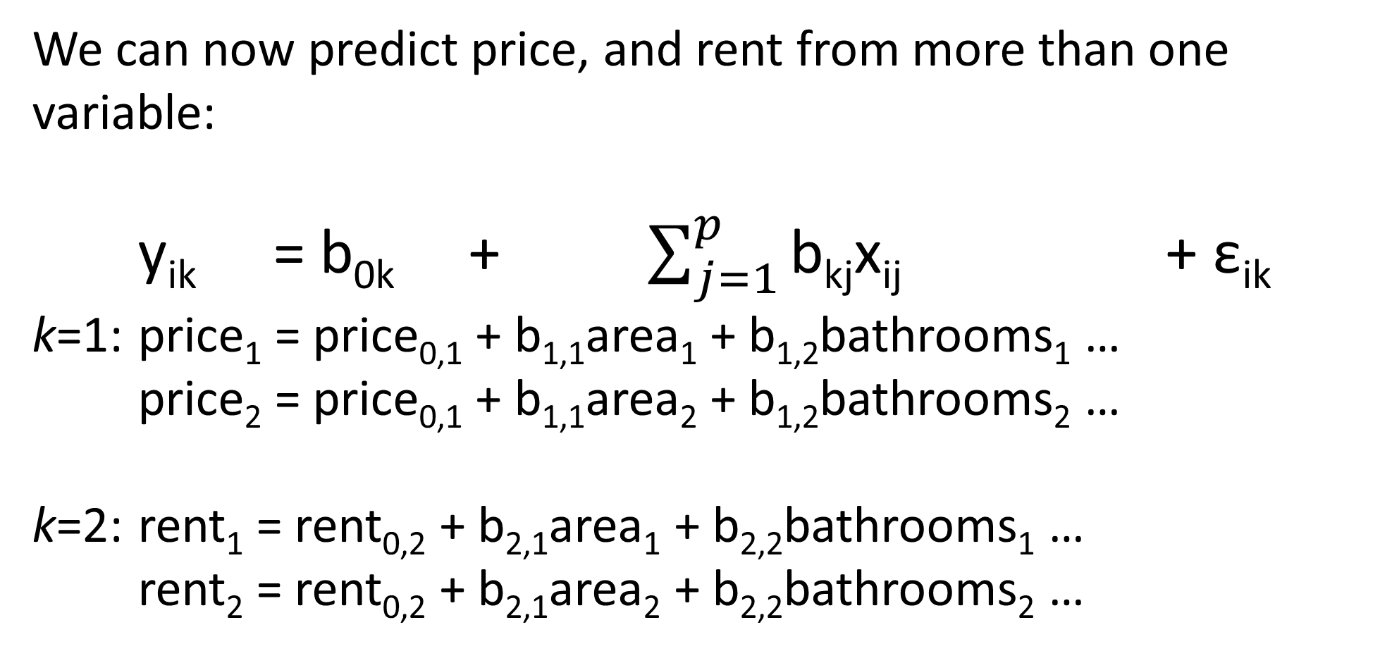
DMO –LR –Advanced II –Multivariate MLR
We can now predict price, and rent from more than one variable:
y_{ik} = b_{0k} + $\sum_{j=1}^{p}{\text{b}\text{kj}\text{x}\text{ij}}$ + ε_{ik}
k=1: price₁ = price_{0,1} + b_{1,1}area₁ + b_{1,2}bathrooms₁ …
price₂ = price_{0,1} + b_{1,1}area₂ + b_{1,2}bathrooms₂ …
k=2: rent₁ = rent_{0,2} + b_{2,1}area₁ + b_{2,2}bathrooms₁ …
rent₂ = rent_{0,2} + b_{2,1}area₂ + b_{2,2}bathrooms₂ …

Slide 40
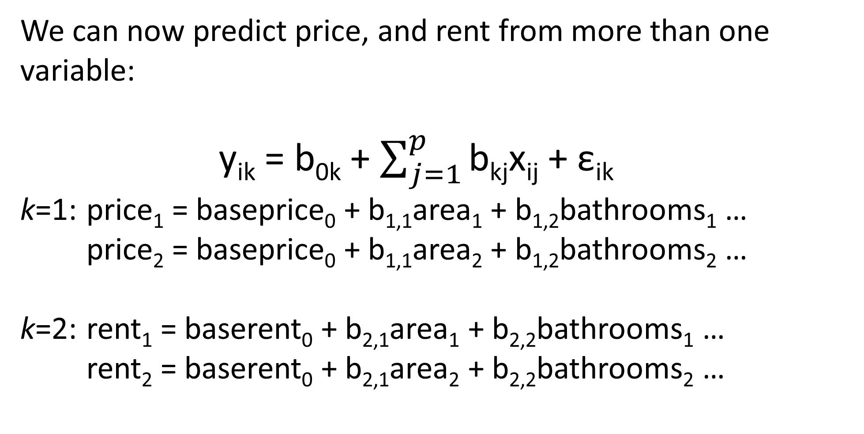
DMO –LR –Advanced II –Multivariate MLR
We can now predict price, and rent from more than one variable:
y_{ik} = b_{0k} + $\sum_{j=1}^{p}{\text{b}\text{kj}\text{x}\text{ij}}$ + ε_{ik}
k=1: price₁ = baseprice₀ + b_{1,1}area₁ + b_{1,2}bathrooms₁ …
price₂ = baseprice₀ + b_{1,1}area₂ + b_{1,2}bathrooms₂ …
k=2: rent₁ = baserent₀ + b_{2,1}area₁ + b_{2,2}bathrooms₁ …
rent₂ = baserent₀ + b_{2,1}area₂ + b_{2,2}bathrooms₂ …

Slide 41
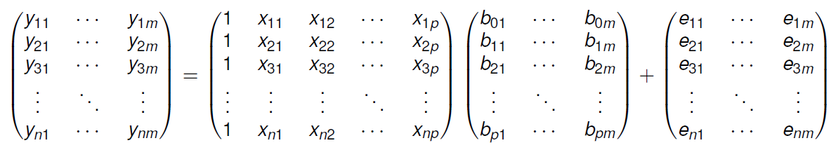

DMO –LR –Advanced II –Multivariate MLR
We can now predict price, and rent from more than one variable:
y_{ik} = b_{0k} + $\sum_{j=1}^{p}{\text{b}\text{kj}\text{x}\text{ij}}$ + ε_{ik}
Y_{i} = b₀ + b_{j}X_{i,j} +... + ε_{i}
So to proceed, we solve COMBINING two methods.

Slide 42
DMO –LR –Advanced II –Multivariate MLR
So to proceed, we solve COMBINING two methods:
Using last multiple LR, do a fit for each dependent variable of interest.
Or use (S/MB)GD!

Slide 43
DMO –LR –Advanced II –Multivariate MLR
We did not really address goodness-of-fit or correlation.
What happens as we add more explanatory variables?
R²→1! (artificially – think about how it is calculated)
So we need a modified R²:
R_{adj}² = 1 – (ResidualMSE/TotalMSE), TotalMSE = σ_{Y}²

Slide 44
Exercises – week 6
Sale ($) | Rent ($) | Area (ft²) | # schools (< 75 km²)
152714 | 2164 | 600 | 3
249728 | 3013 | 600 | 8
227593 | 3700 | 1600 | 7
279549 | 4182 | 1700 | 8
126661 | 3297 | 1750 | 2
161995 | 3831 | 1900 | 2
235660 | 4112 | 2150 | 6
276649 | 4937 | 2200 | 7
136340 | 3633 | 2200 | 1
129620 | 3623 | 2200 | 1
185623 | 4231 | 2300 | 2
184213 | 3868 | 2650 | 1
306665 | 6015 | 3000 | 9
268600 | 5543 | 3250 | 5
318616 | 6363 | 3500 | 8
262120 | 5824 | 3550 | 5
277917 | 5800 | 3550 | 6
324790 | 6083 | 3650 | 7
271142 | 6227 | 3650 | 6
379957 | 6579 | 3750 | 9
302951 | 6140 | 3750 | 8
331180 | 6417 | 4200 | 8
333283 | 6557 | 4200 | 8
358939 | 6358 | 4250 | 7
368868 | 7337 | 4350 | 9
280865 | 6011 | 4400 | 3
277215 | 6944 | 4550 | 5
429795 | 7351 | 4550 | 10
227072 | 6561 | 4800 | 1
308815 | 7433 | 4850 | 6
In python/excel, use the data below to figure out the relationships. Use OLS/GD do a full workup and comment.
-graphs?
-KPIs/metrics?
-SA…
-conclusions

